Slide 1
Understanding data
20/3/2019

Slide 2
Learning objectives
What is data.
Different types and attributes of data.
Why understanding data characteristics is important in the world today.

Slide 3
Data Modules
The 3 data modules are
Data
Aggregations
Distribution

Slide 4
Data
This module will cover the following
Different types of data – Continuous, Categorical and discrete
Attributes of data – Nominal, Ordinal, Interval and ratio.
The unique aspect of data – Time.

Slide 5
Aggregations
Aggregations were built from different set of data.
It takes data and use different functions and builds it up for use and analysis and visualization.

Slide 6
Distributions
Distributions will take look at how data and aggregations can be shaped.
What those shapes mean? And how it helps analytics.
We will have a look over “Standard deviation” and explore how it is a part of distribution.

Slide 7
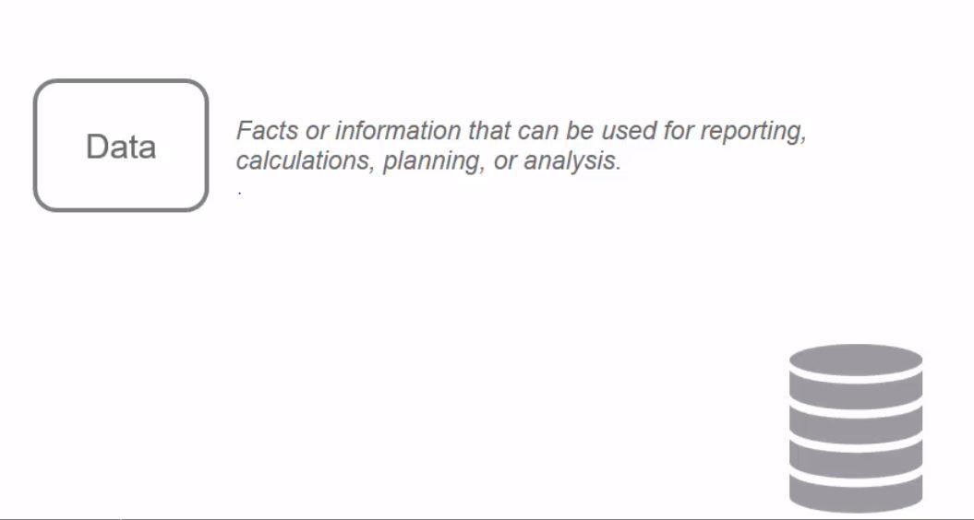
What is data?

Slide 8
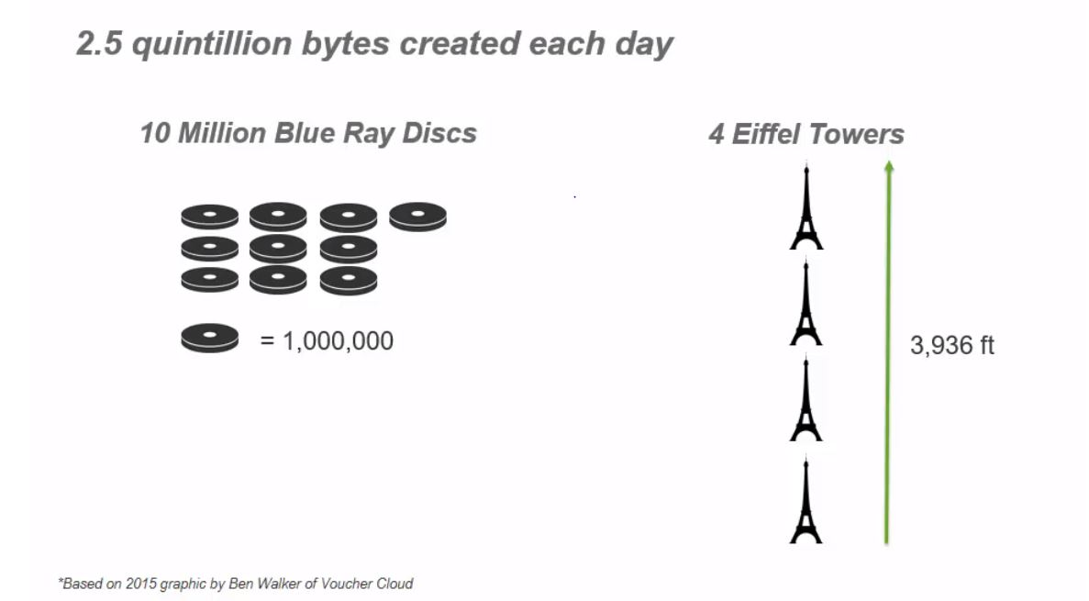
The world of data

Slide 9
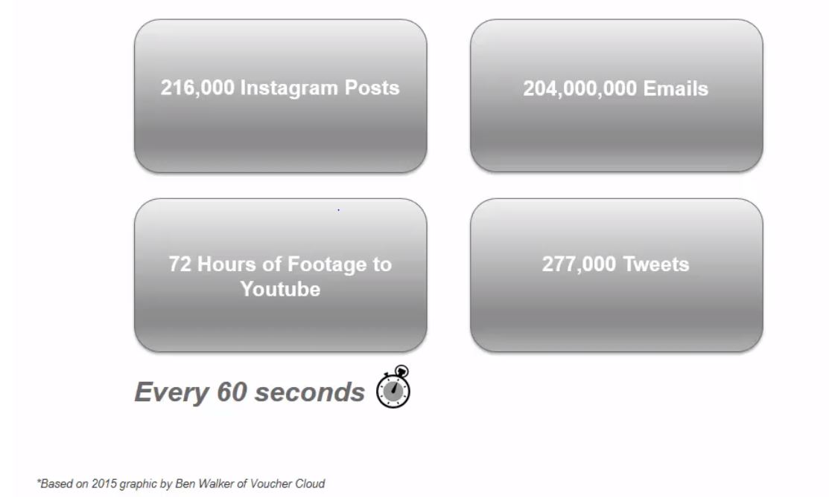
Date created per minute

Slide 10
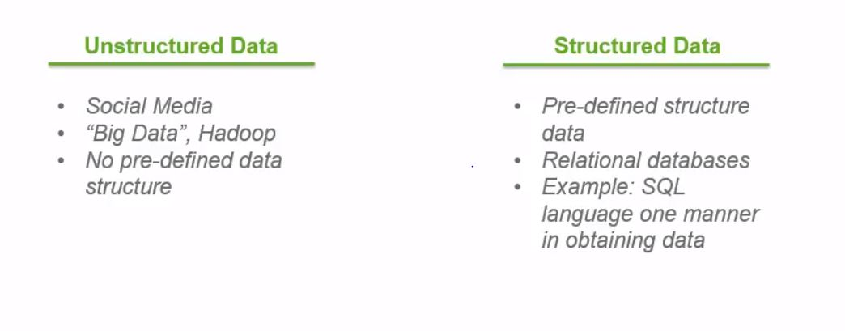
Nature of data

Slide 11
Nature of data
The unstructured data don’t have a data structure to it’s setup.
Analyzing unstructured data allows analysts to find sentiment, trends, feelings towards products and services, which can then be used for business purposes.
Examples of structured data are information on metrics on companies, applications of credit cards, sales and revenue numbers in quarters, data warehouses.

Slide 12
Analyzing data in back end
Data is used to build back end systems like database warehouse.
If the data is not optimized in back end system by data architecture, which doesn’t meets the need of business analyst or user, the analysis has the strong chance of being incorrect

Slide 13
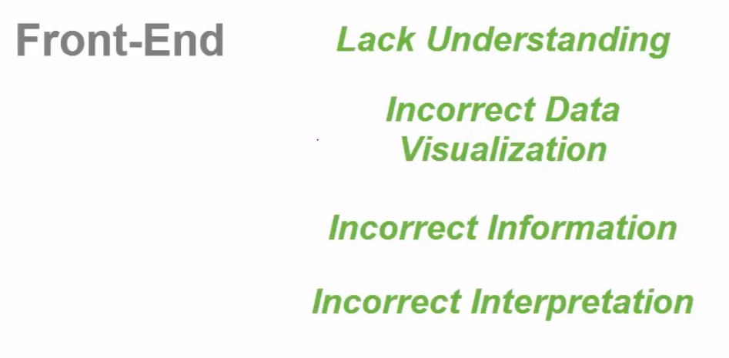
Analyzing data in front end

Slide 14
Analyzing data in front end
There is a greater chance of obtaining the incorrect analysis in front end, due to the following reasons
Lack of knowledge on data types and how it should be used.
Using incorrect visualization
Giving incorrect information to different parties and organization.

Slide 15
Data purposes
‘Tweets’ can be used for analyzing opinions.
“Revenue and company statistics” can be used for forecasts.
“Customers and Demographics” can be used for targeted marketing.

Slide 16
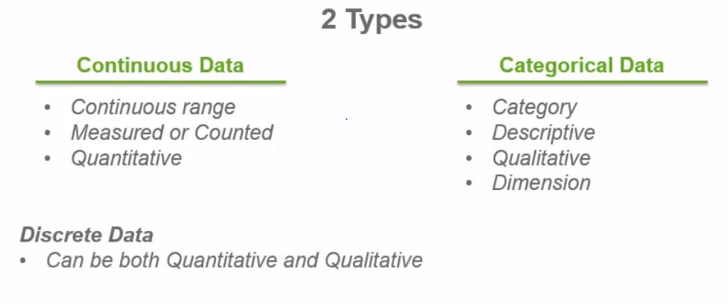
Types of data

Slide 17
Types of data
Continuous data can vary on a continuous range.
It is a measurement data. Eg: Height and it is a quantitative data.
Qlik uses continuous data as ‘Measure’.
Categorical data is not continuous and takes on certain values. Eg: Gender.
The data here is specific, categorical and can be used as descriptive type of analysis.
Categorical data is qualitative and it is considered as ‘Dimension’.
Apart from these 2, there is one more type called “Discrete data” which is both continuous and categorical. Example: Number of students in a class.

Slide 18
Identify the type of the following data - Quiz
Profit margin
Product type
Mountain height
Car model
Number of whole apples in a barrel

Slide 19
Answers
Profit margin - Continuous
Product type - Categorical
Mountain height - Continuous
Car model - Categorical
Number of whole apples in a barrel - Discrete

Slide 20
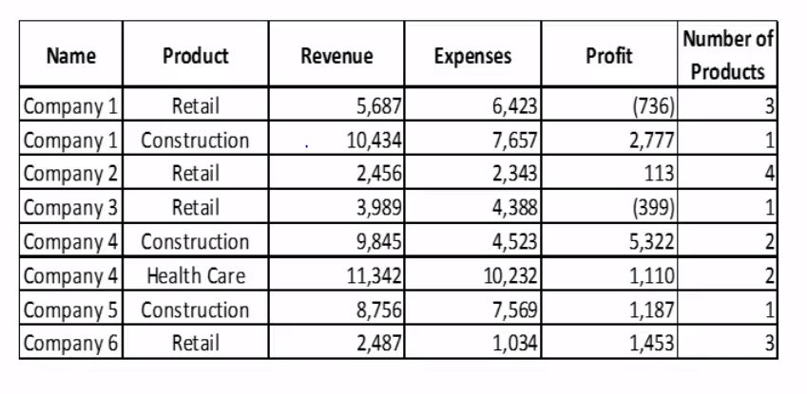
Quiz #2 – Identify the type of data

Slide 21
Answer
Continuous:
Name, Product
Categorical:
Revenue, Expenses, Profit
Discrete:
Number of products

Slide 22
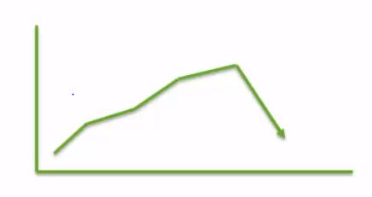
Why studying data is important?
Consider the example that you are given a graph of deviation in revenue and profit in your company for different regions.
In the graph, you absorb a sudden decline in the graph for a particular month and you are asked to find the reason of that to happen and to create a presentation for that.

Slide 23
Solution
If you have previous knowledge on type of the data used, you can easily create visualization on that.
In the given example, product is categorical, profit is continuous and the count of sales is discrete.
Using these, we can easily create a vizualization region wise and identify the cause of decline in different regions and work on those.

